Slide 1
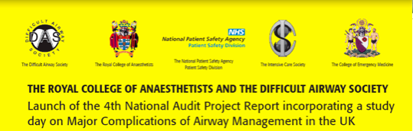
Problems at Extubation and Recovery
Audrey Quinn, The Infirmary at Leeds
Notes:
I’m going to talk today on the NAP4 findings in patients reported to have problems at extubation and recovery. 15 mins to summarise 38 cases of some considerable complexity. I’d recommend you to the chapter where more patient details- I certainly have learned a great deal. I’d like to thank those anaesthetists who took considerable time & trouble to submit these reports + Nick my co-author for his invaluable input & guidance

Slide 2
Aims of presentation
Primary Findings
Common causes of airway obstruction
Other less common causes
Extubation planning
Staff, training & equipment

Slide 3
Primary findings
38 of 133 reports (28%) in “Anaesthesia group”
In all cases airway obstruction was root cause
Two died, one sustained brain damage
Remaining patients were admitted to ICU. (moderate harm)
10 ESA were attempted, 8 successful
Notes:
In all cases airway obstruction was root cause As opposed to hypoventilation, aspiration or effects of drugs etc
Remaining patients were admitted to ICU, one patient for 30 days

Slide 4
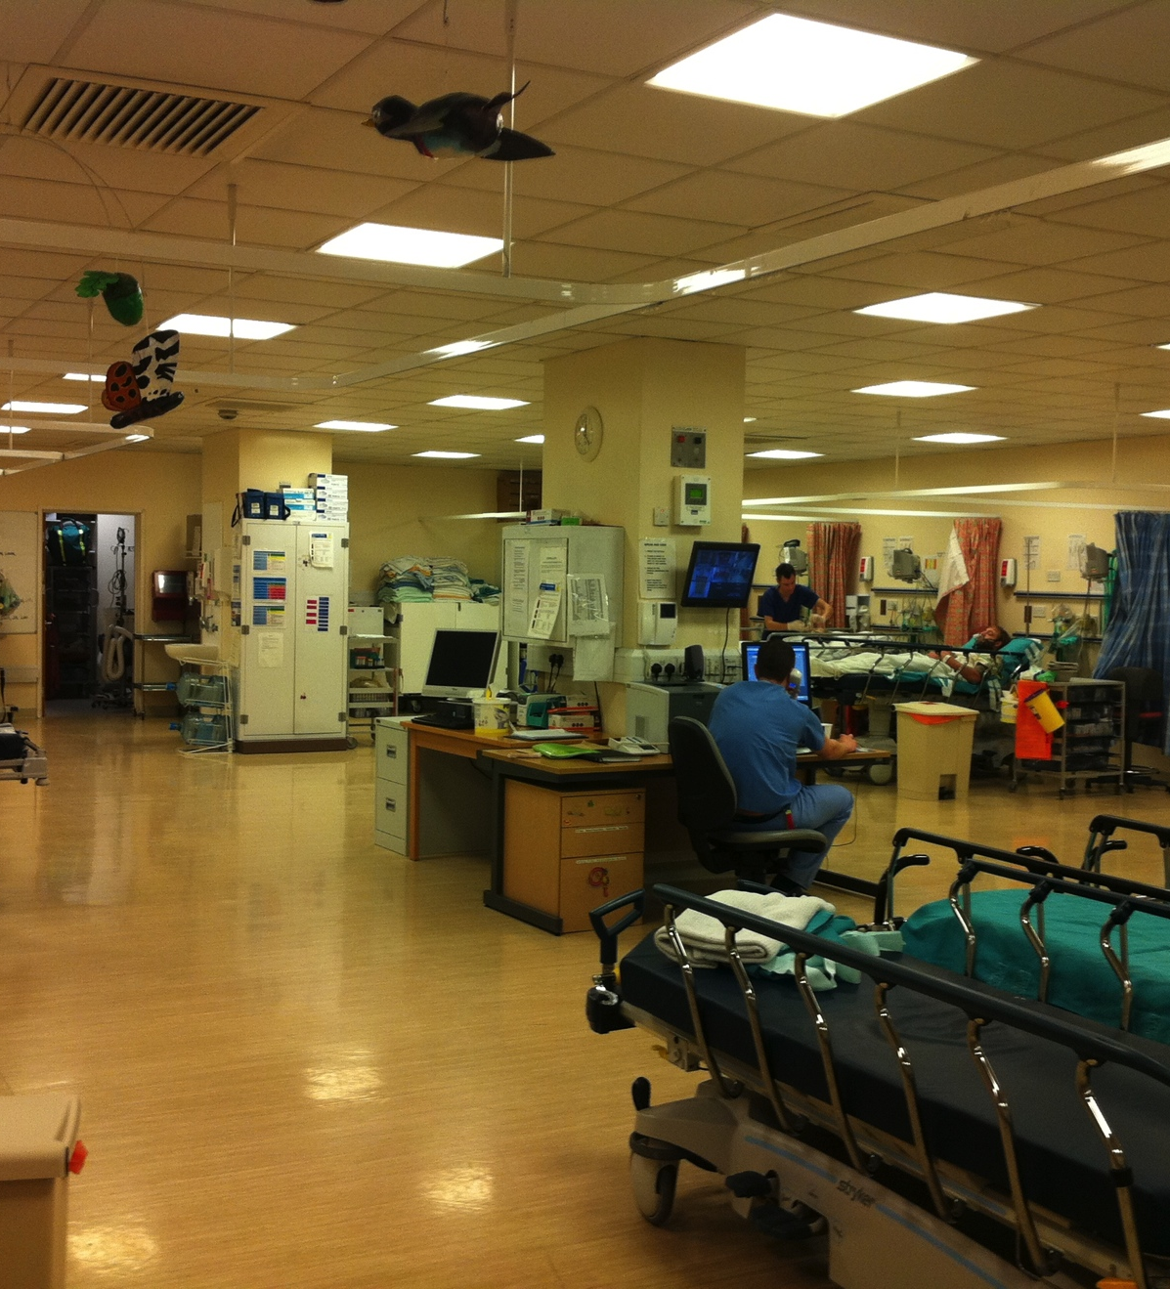
Post Anaesthetic Care Unit
2/3 consultant case, 75% elective/scheduled in daytime
In half: difficulty predicted
In half, there was delay in recognising the problem
5 cases required CPR consequent to hypoxia
Airway management: Good(8), poor (10), mixed (18)

Slide 5
Common causes of airway obstruction
Tracheal tube (24)
Supraglottic airway device(8).
Laryngospasm
20 cases in OR , 16 cases Recovery
Upper airway obstruction led to post obstructive pulmonary oedema (13)
Obesity asthma or COPD were the most common co-morbidities.

Slide 6
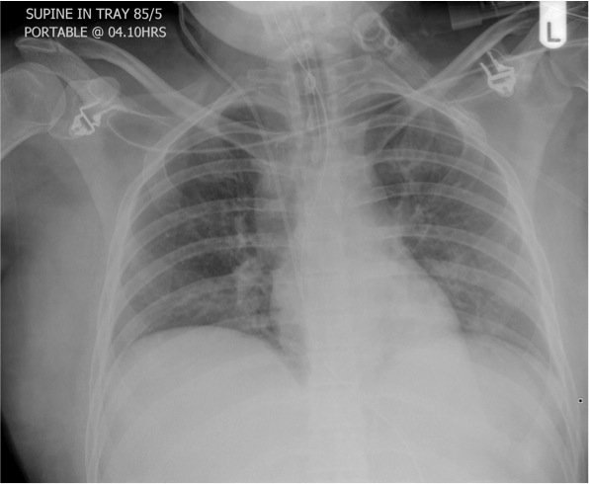
Post obstructive
Pulmonary oedema
Young healthy patients, Middle aged patient
TT, SAD, after airway removed
Severe hypoxia, not responsive to CPAP
All ICU for IPPV
12/13 made full recovery
Notes:
We saw a severe degree of hypoxia. The POPO cases were not predictable- in young healthy patients with SAD, obesity, laryngospasm cases and one occurred silently in a young patient with facial fractures without any obvious obstruction, but also a middle aged lady biting on TT,. CPAP was no good &ICU admission required for all for ventilation
Left upper lobe there are big blood vessels and oedema round bronchi

Slide 7
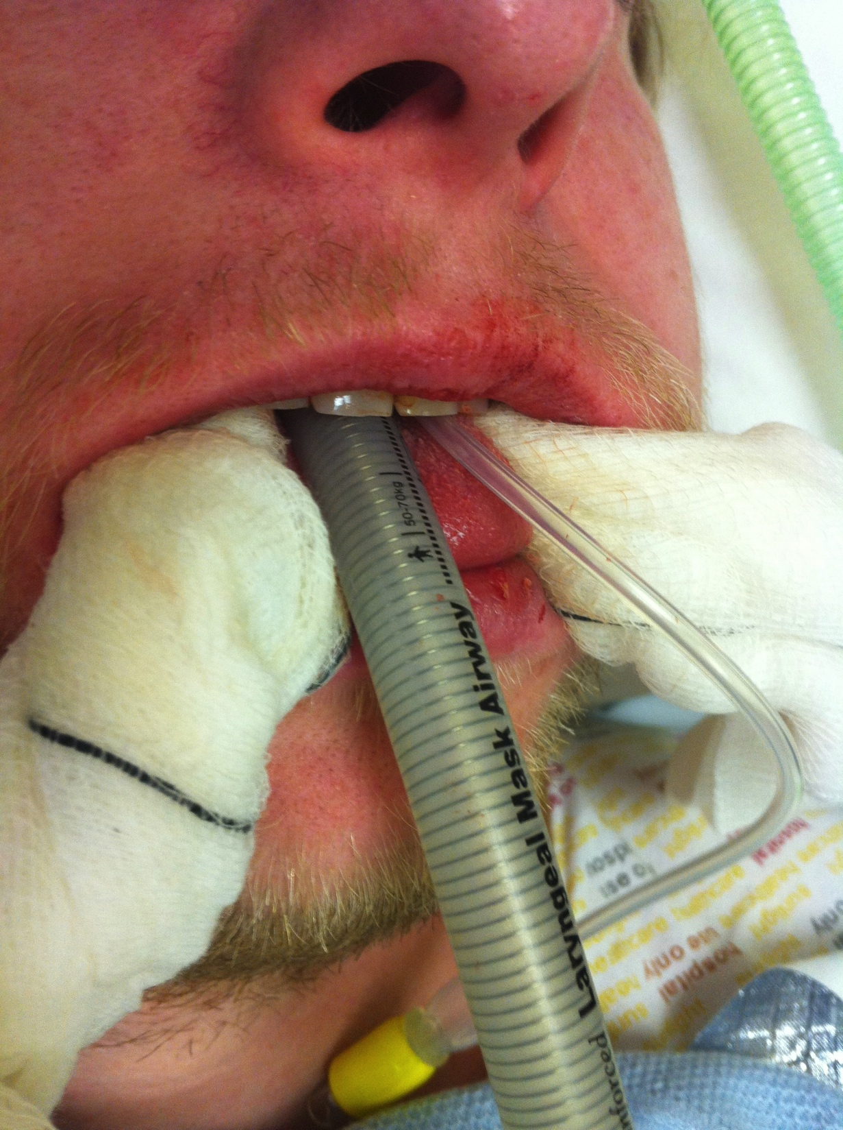
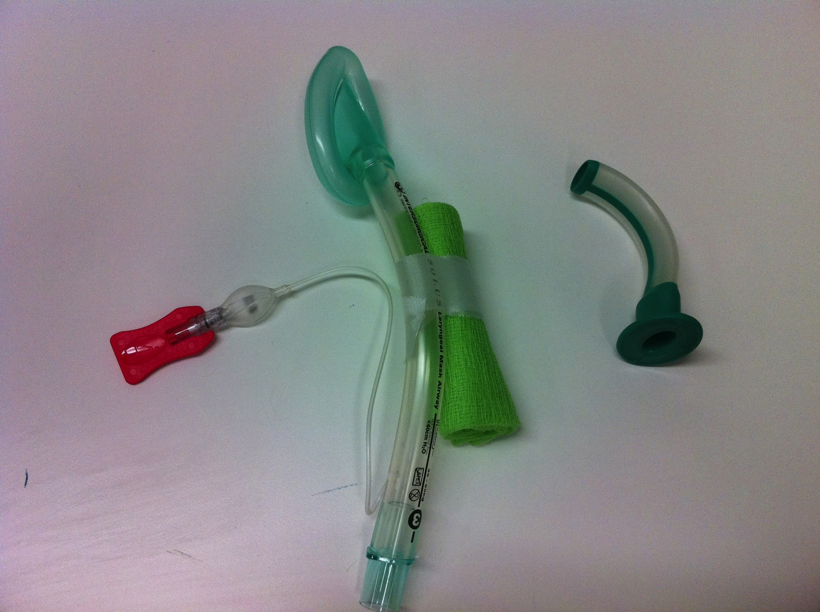

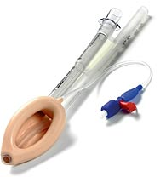
Biting on airway
Obstruction by patient biting on airway
A bite block, oropharyngeal airway, SAD + integral bite block.
Notes:
We saw many cases where airway was obstructed by patient biting on airway. There are simple things we can do to prevent this: A bite bloc made from green gauze inserted and taped onto mask after insertion, an oropharyngeal airway, some SADs eg proseal or iGel have integral bite block.

Slide 8
Other causes of airway obstruction
Bleeding into the airway
requires careful inspection and suctioning before controlled extubation.
Laryngeal oedema
followed several operations and 3 in the Trendelenburg or head down position
Neck haematoma
produced airway oedema and hampered re-intubation.
Notes:
Some of our most serious cases fell into this group. 16 of events followed surgery in the airway- poor extubation & planning after extubation in this group
Neck haematoma produced airway oedema and hampered re-intubation, even where direct laryngoscopy was previously easy. Carotid thyroid & cx spine surgery.
A throat pack was left in following lumbar spine surgery causing drowsiness & hypoxia for prolonged period in recovery

Slide 9
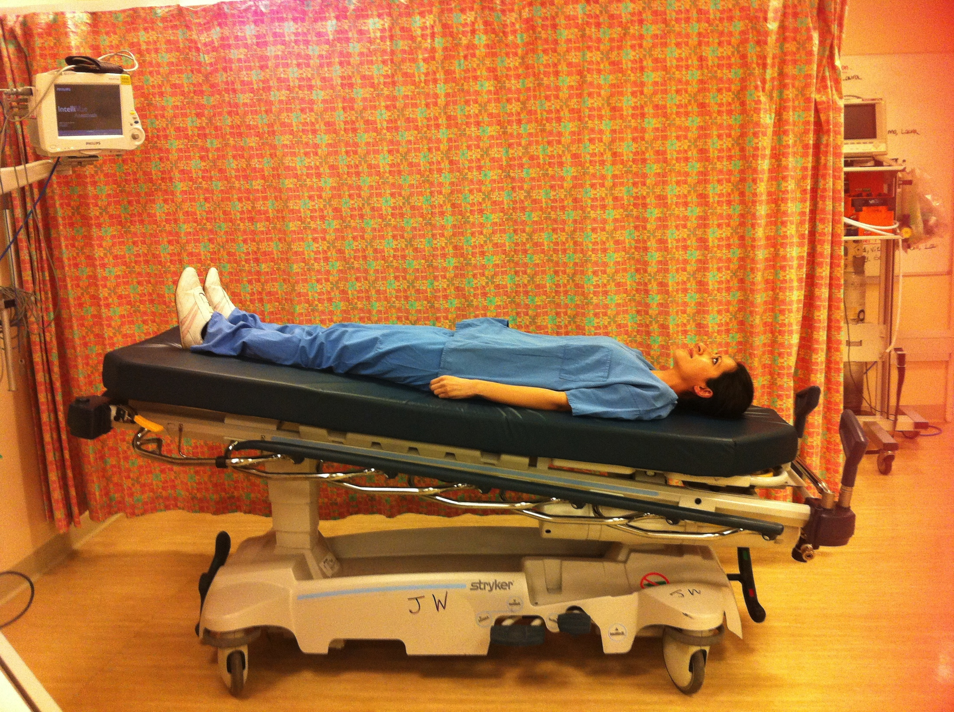
Procedures associated with problems in recovery
ENT, Maxfax
Trendellenberg
Airway oedema in 3 cases
6h prostatectomy, shorter gynae cases. Visualised via SAD. Trachy in one
13 ENT and 5 OMF
Surgery took place within the airway of 16 of the 38
4 of these this was by laser
1 case had a stent

Slide 10
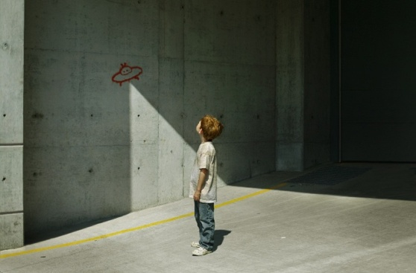
Airway Extubation plan
Airway Management plan
Patients should be assessed and optimised
(including effective neuromuscular function, pre-oxygenation and appropriate airway toilet).
Extubation in theatre & team assembled
(may include specific techniques for re-intubation).
The recovery staff should be aware of ongoing management plan.
Notes:
Can’t stress enough: pts should be assessed & optimised. I’ve started writing a summary in anaesthetic sheet nxt to instructions to staff on O2, analgesia & fluids.
Don’t routinely extubate in recovery unless special circumstances.
Routine items were missing in cases- if you intubate with a McCoy and bougie- take them to recovery. If you need a smaller tube- hold into it after extubation
Give recovery staff explicit instructions Potential problems, signs, what to do, what staff and equipment needed.

Slide 11
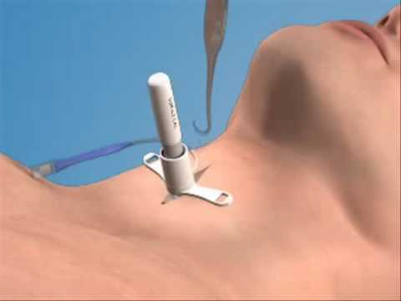
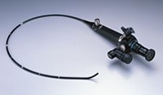
Techniques requiring expertise
“Assistance was requested but the anaesthetic department was short- staffed that day and no senior help was available to assist..”
Notes:
There were 3 FOI and 10 ESA Staff must be available with the expertise to do these
Some units have a named consultant policy who should be free to help, others talked of a roving or duty consultant. But there were also problems getting help and I quote

Slide 12
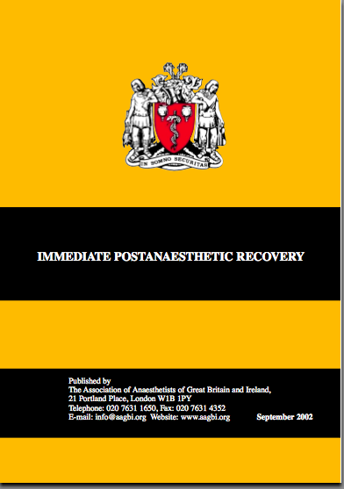
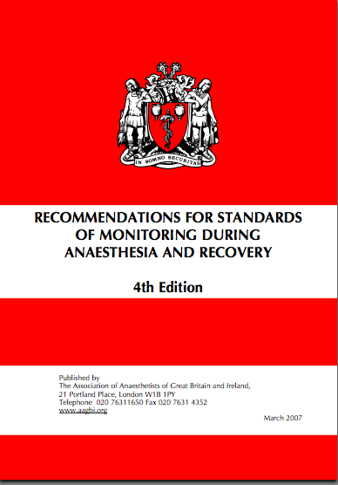
Supplementary oxygen and monitoring is needed for transport after GA
Notes:
Supplementary oxygen and monitoring is needed for transport after GA. We have AAGBI documents with clear guidance. 2 patients arrived in recovery hypoxic, suffered cardiac arrest and died. One a 4 year old post tonsillectomy with total airway obstruction from blood clot.

Slide 13
Recommendations:
Equipment, staff & training
Recovery Staff should be trained to agreed standard
Senior staff should be available to help
A full range of airway equipment should be available in recovery
Capnography should be available in recovery
Patients who had, or could have airway problems should be re-assessed before discharge from recovery.
Notes:
Recovery room staff should be trained to an agreed standard in all hospital sites. One case reported: trainee forgot to mention jaw thrust needed-to recovery staff who should know this in any event. Midwives are not recovery competency trained. Core competencies document coming from AAGBI soon.
A full range of difficult airway equipment and experienced staff should be readily accessible in recovery; capnography should be available in recovery for high risk cases. Routine capnography might have enabled earlier detection of airway obstruction in some cases, if it had been available and staff trained in its use. Can be used with SADs and facemaskswith capnograph connections
Patients who have had, or potentially have airway problems should be re-assessed by the responsible anaesthetist before discharge.

Slide 14
“The trainee anaesthetist was slow to ask for help (the recovery staff did) and two consultants arrived within a few minutes…”
“ Propofol and suxamethonium were given but an appropriate size tracheal tube was not available and it took five minutes obtain..”
The airway was established with AFOI and a small tracheal tube…patient was transferred still intubated to recovery and then extubated..Airway obstruction developed, a junior trainee attended ..patient required urgent reintubation. After a delay of at least five minutes a consultant arrived..”
Notes:
Last quote: Could this happen in your hospital?

Slide 15
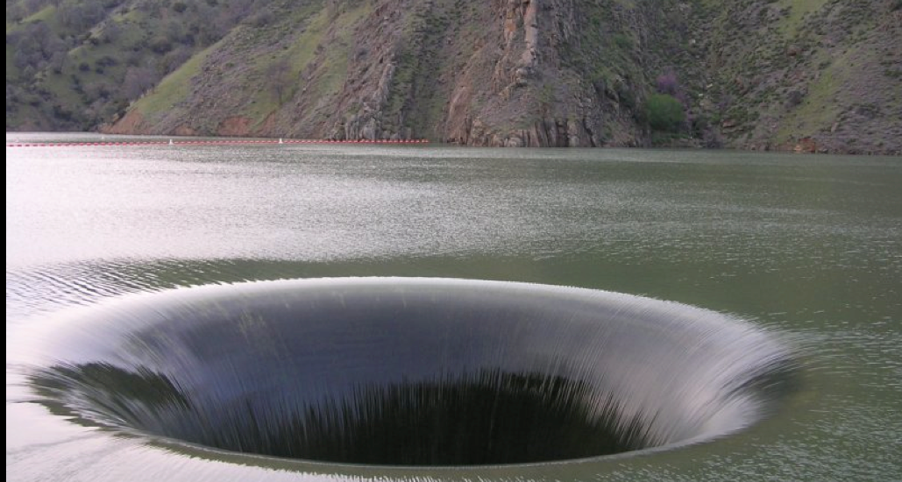
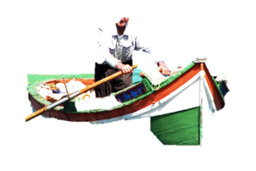
Is there a way out of this?
Notes:
This man has two paddles and can escape the black hole. We have to think carefully about what we do and how we can avoid going down our hole.

Slide 16
 | Causal | Contributory | Positive
Communication | 1 | 10 | 11
Education & training | 0 | 18 | 5
Equipment & resources | 1 | 6 | 8
Medication | 0 | 7 | 1
Organisation & strategic | 1 | 7 | 7
Patient | 8 | 22 | 0
Task | 1 | 5 | 3
Team & specific | 0 | 8 | 3
Work & environment | 0 | 4 | 1
Judgement | 3 | 18 | 6
Other | 0 | 4 | 0
Notes:
This table shows what the NAP4 panel thought of each report in this section: which factors were causal or contributory to the problem or were positive with good management. Aside from patient factors, only a few cases in the causal column. Of interest there were positive comments on good communication (although same no in contributory column), some had good equipment, and some showed good organisation. There were 6 reports where judgement was considered good although three times this no. showed defective judgement in management of the case.

Slide 17

NAP4 Recovery problems
(tip of the iceberg)
Notes:
I hope this talk gives you an idea of the problems reported following extubation and recovery from anaesthesia. We have seen serious airway problems but there will be many less severe problems not reported (and we also think the NAP4 cases have also probably been underreported). This is an area that requires our attention.
I thank you for yours.

